Slide 1
Discrete Mathematics, Part III CSE 2353
Fall 2007
Margaret H. Dunham
Department of Computer Science and Engineering
Southern Methodist University
Some slides provided by Dr. Eric Gossett; Bethel University; St. Paul, Minnesota
Some slides are companion slides for Discrete Mathematical Structures: Theory and Applications by D.S. Malik and M.K. Sen

Slide 2
Outline
Introduction
Sets
Logic & Boolean Algebra
Proof Techniques
Counting Principles
Combinatorics
Graphs/Trees
Boolean Functions, Circuits

Slide 3
Combinatorics
As we are slightly behind schedule this semester – we will not cover this topic.
Problem Solving
The counting topics we examined are really part of combinatorics
  http://en.wikipedia.org/wiki/Combinatorics
Many fun problems
  http://www.mathpages.com/home/icombina.htm

Slide 4
Outline
Introduction
Sets
Logic & Boolean Algebra
Proof Techniques
Counting Principles
Combinatorics
Relations,Functions
Graphs/Trees
Boolean Functions, Circuits

Slide 5
Learning Objectives
Learn about relations and their basic properties
Explore equivalence relations
Become aware of closures
Learn about posets
Explore how relations are used in the design of relational databases

Slide 6

Relations
Relations are a natural way to associate objects of various sets
© Discrete Mathematical Structures: Theory and Applications

Slide 7
Representing Relations
Set – ordered pairs
Set definition – membership values
Arrow Diagram
Digraph (Directed Graph)

Slide 8
Relations
Arrow Diagram
  Write the elements of A in one column
  Write the elements B in another column
  Draw an arrow from an element, a, of A to an element, b, of B, if (a ,b) ∈ R
  Here, A = {2,3,5} and B = {7,10,12,30} and R from A into B is defined as follows: For all a ∈ A and b ∈ B, a R b if and only if a divides b
  The symbol → (called an arrow) represents the relation R
© Discrete Mathematical Structures: Theory and Applications

Slide 9
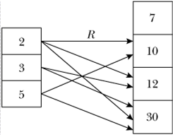
Relations
© Discrete Mathematical Structures: Theory and Applications

Slide 10
Relations
Directed Graph
  Let R be a relation on a finite set A
  Describe R pictorially as follows:
    For each element of A , draw a small or big dot and label the dot by the corresponding element of A
    Draw an arrow from a dot labeled a , to another dot labeled, b , if a R b .
    Resulting pictorial representation of R is called the directed graph representation of the relation R
© Discrete Mathematical Structures: Theory and Applications

Slide 11
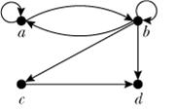
Relations
© Discrete Mathematical Structures: Theory and Applications

Slide 12
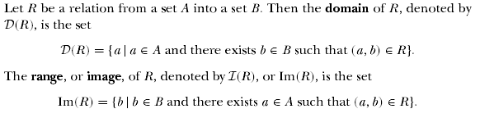
Relations
How do these definitions compare to Defn 12.5 on p732 in your book?
© Discrete Mathematical Structures: Theory and Applications

Slide 13
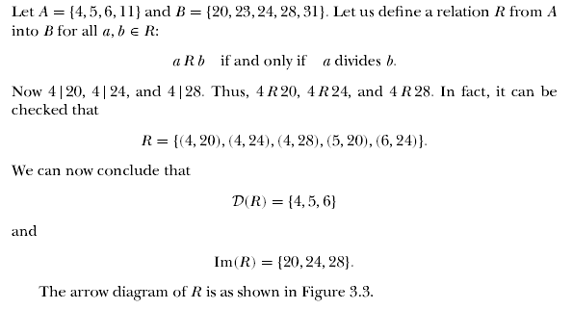
Relations
© Discrete Mathematical Structures: Theory and Applications

Slide 14
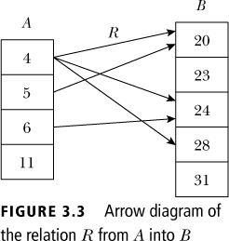
Relations
© Discrete Mathematical Structures: Theory and Applications

Slide 15

Inverse of Relations
  Let A = {1, 2, 3, 4} and B = {p, q, r}. Let R = {(1, q), (2, r ), (3, q), (4, p)}. Then R⁻¹ = {(q, 1), (r , 2), (q, 3), (p, 4)}
  To find R⁻¹, just reverse the directions of the arrows
  D(R) = {1, 2, 3, 4} = Im(R⁻¹), Im(R) = {p, q, r} = D(R⁻¹)
© Discrete Mathematical Structures: Theory and Applications

Slide 16
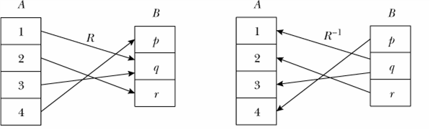
Inverse of Relations
© Discrete Mathematical Structures: Theory and Applications

Slide 17
Composition of Relations
Le R be a relations whose domain is A and whose image is B. Let S be a relation whose domain contains B and whose range is C. The composition of S and R is a subset of AXC. It is defined by:
Compositive is Associative

Slide 18
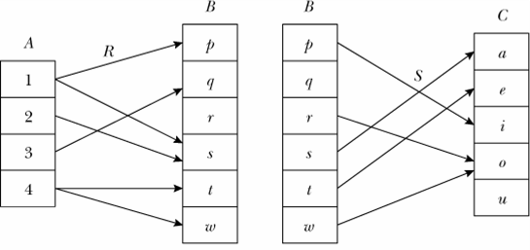
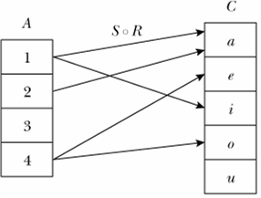
Composition of Relations
Example:
  Consider the relations R and S as given above
  The composition S ◦ R is shown on the right
© Discrete Mathematical Structures: Theory and Applications

Slide 19
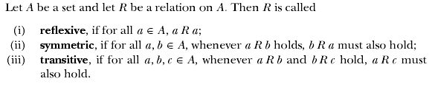
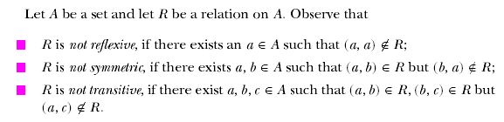
Properties of Relations
© Discrete Mathematical Structures: Theory and Applications

Slide 20

Equivalence Relations
© Discrete Mathematical Structures: Theory and Applications

Slide 21
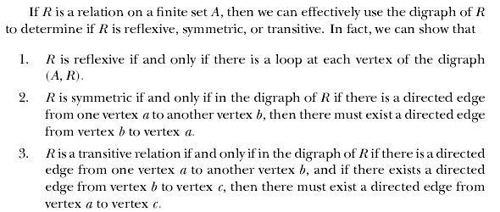
Equivalence Relations
© Discrete Mathematical Structures: Theory and Applications

Slide 22
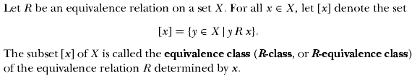
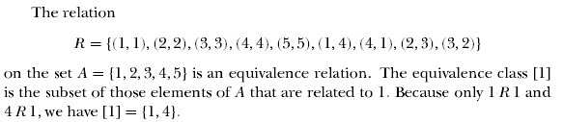
Equivalence Relations
© Discrete Mathematical Structures: Theory and Applications

Slide 23
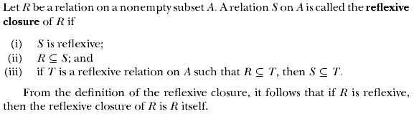
Closure of Properties on Relations
Compare to Definition 12.13 on p738 in your book
© Discrete Mathematical Structures: Theory and Applications

Slide 24
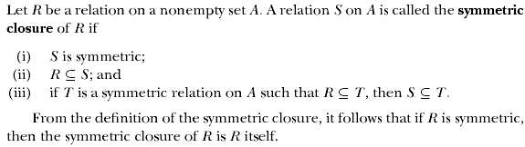
Closure of Properties on Relations
Compare to Definition 12.13 on p738 in your book
© Discrete Mathematical Structures: Theory and Applications

Slide 25
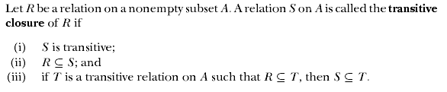
Closure of Properties on Relations
Compare to Definition 12.13 on p738 in your book
© Discrete Mathematical Structures: Theory and Applications

Slide 26
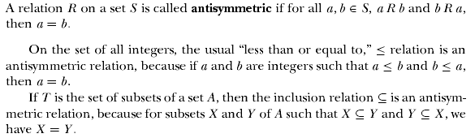
Partially Ordered Sets
© Discrete Mathematical Structures: Theory and Applications

Slide 27
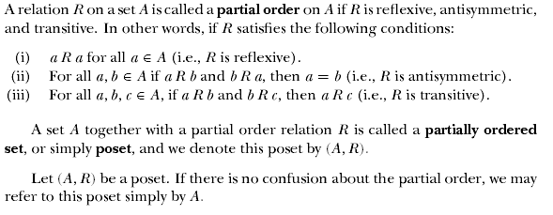
Partially Ordered Sets
© Discrete Mathematical Structures: Theory and Applications

Slide 28
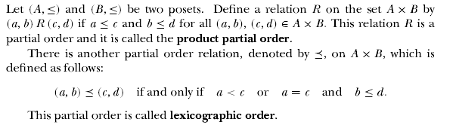
Partially Ordered Sets
© Discrete Mathematical Structures: Theory and Applications

Slide 29


Partially Ordered Sets
© Discrete Mathematical Structures: Theory and Applications

Slide 30
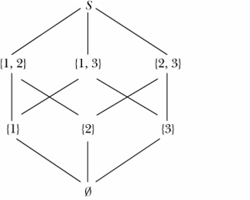
Partially Ordered Sets
Hasse Diagram
  Let S = {1, 2, 3}. Then P(S) = {∅, {1}, {2}, {3}, {1, 2}, {2, 3}, {1, 3}, S}
  Now (P(S),≤) is a poset, where ≤ denotes the set subset relation. The poset diagram of (P(S),≤) is shown

Slide 31
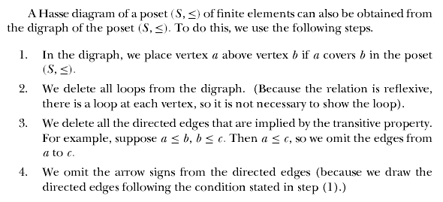
Partially Ordered Sets
© Discrete Mathematical Structures: Theory and Applications

Slide 32

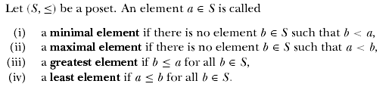
Partially Ordered Sets
© Discrete Mathematical Structures: Theory and Applications

Slide 33
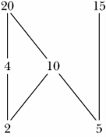
Partially Ordered Sets
Hasse Diagram
  Consider the poset (S,≤), where S = {2, 4, 5, 10, 15, 20} and the partial order ≤ is the divisibility relation.
  2 and 5 are the only minimal elements of this poset.
  This poset has no least element.
  20 and 15 are the only maximal elements of this poset.
  This poset has no greatest element.
© Discrete Mathematical Structures: Theory and Applications

Slide 34
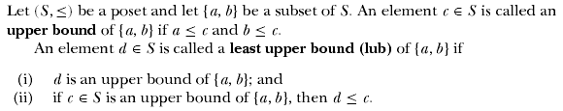
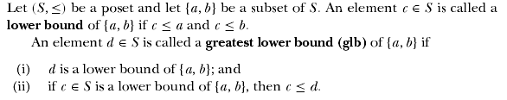
Partially Ordered Sets
© Discrete Mathematical Structures: Theory and Applications

Slide 35
Application: Relational Database
A database is a shared and integrated computer structure that stores
  End-user data; i.e., raw facts that are of interest to the end user;
  Metadata, i.e., data about data through which data are integrated
  A database can be thought of as a well-organized electronic file cabinet whose contents are managed by software known as a database management system; that is, a collection of programs to manage the data and control the accessibility of the data

Slide 36
Application: Relational Database
In a relational database system, tables are considered as relations
A table is an n-ary relation, where n is the number of columns in the tables
The headings of the columns of a table are called attributes, or fields, and each row is called a record
The domain of a field is the set of all (possible) elements in that column

Slide 37
Application: Relational Database
Each entry in the ID column uniquely identifies the row containing that ID
  Such a field is called a primary key
  Sometimes, a primary key may consist of more than one field

Slide 38
Application: Relational Database
Structured Query Language (SQL)
  Information from a database is retrieved via a query, which is a request to the database for some information
  A relational database management system provides a standard language, called structured query language (SQL)
  A relational database management system provides a standard language, called structured query language (SQL)

Slide 39
Application: Relational Database
Structured Query Language (SQL)
  An SQL contains commands to create tables, insert data into tables, update tables, delete tables, etc.
  Once the tables are created, commands can be used to manipulate data into those tables.
  The most commonly used command for this purpose is the select command. The select command allows the user to do the following:
    Specify what information is to be retrieved and from which tables.
    Specify conditions to retrieve the data in a specific form.
    Specify how the retrieved data are to be displayed.

